Slide 1

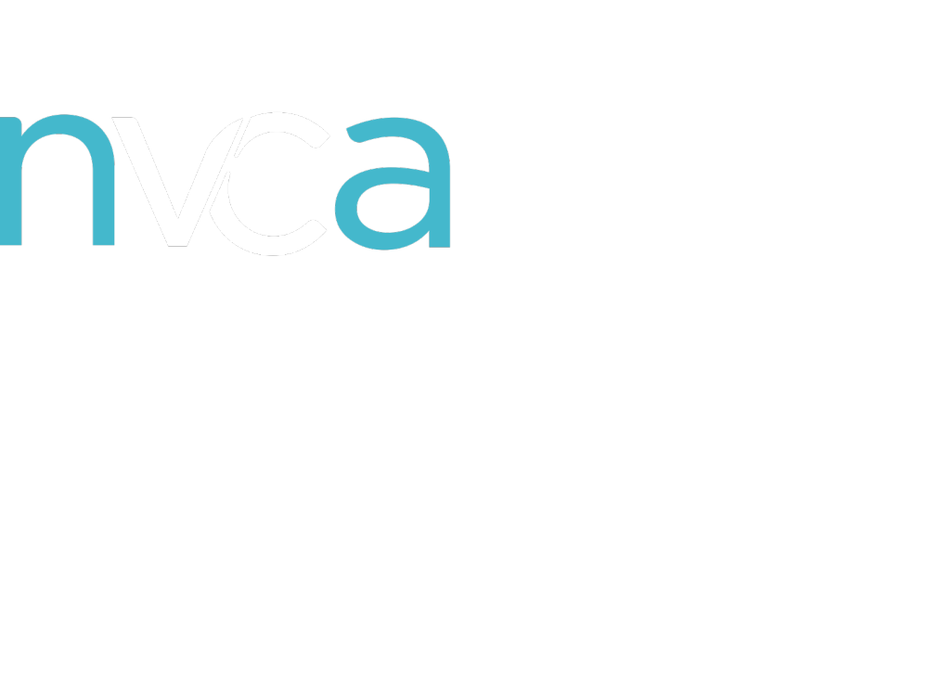
Venture Capital 101: The Basics of Venture Investing
Presented by
December 17, 2024

Slide 2
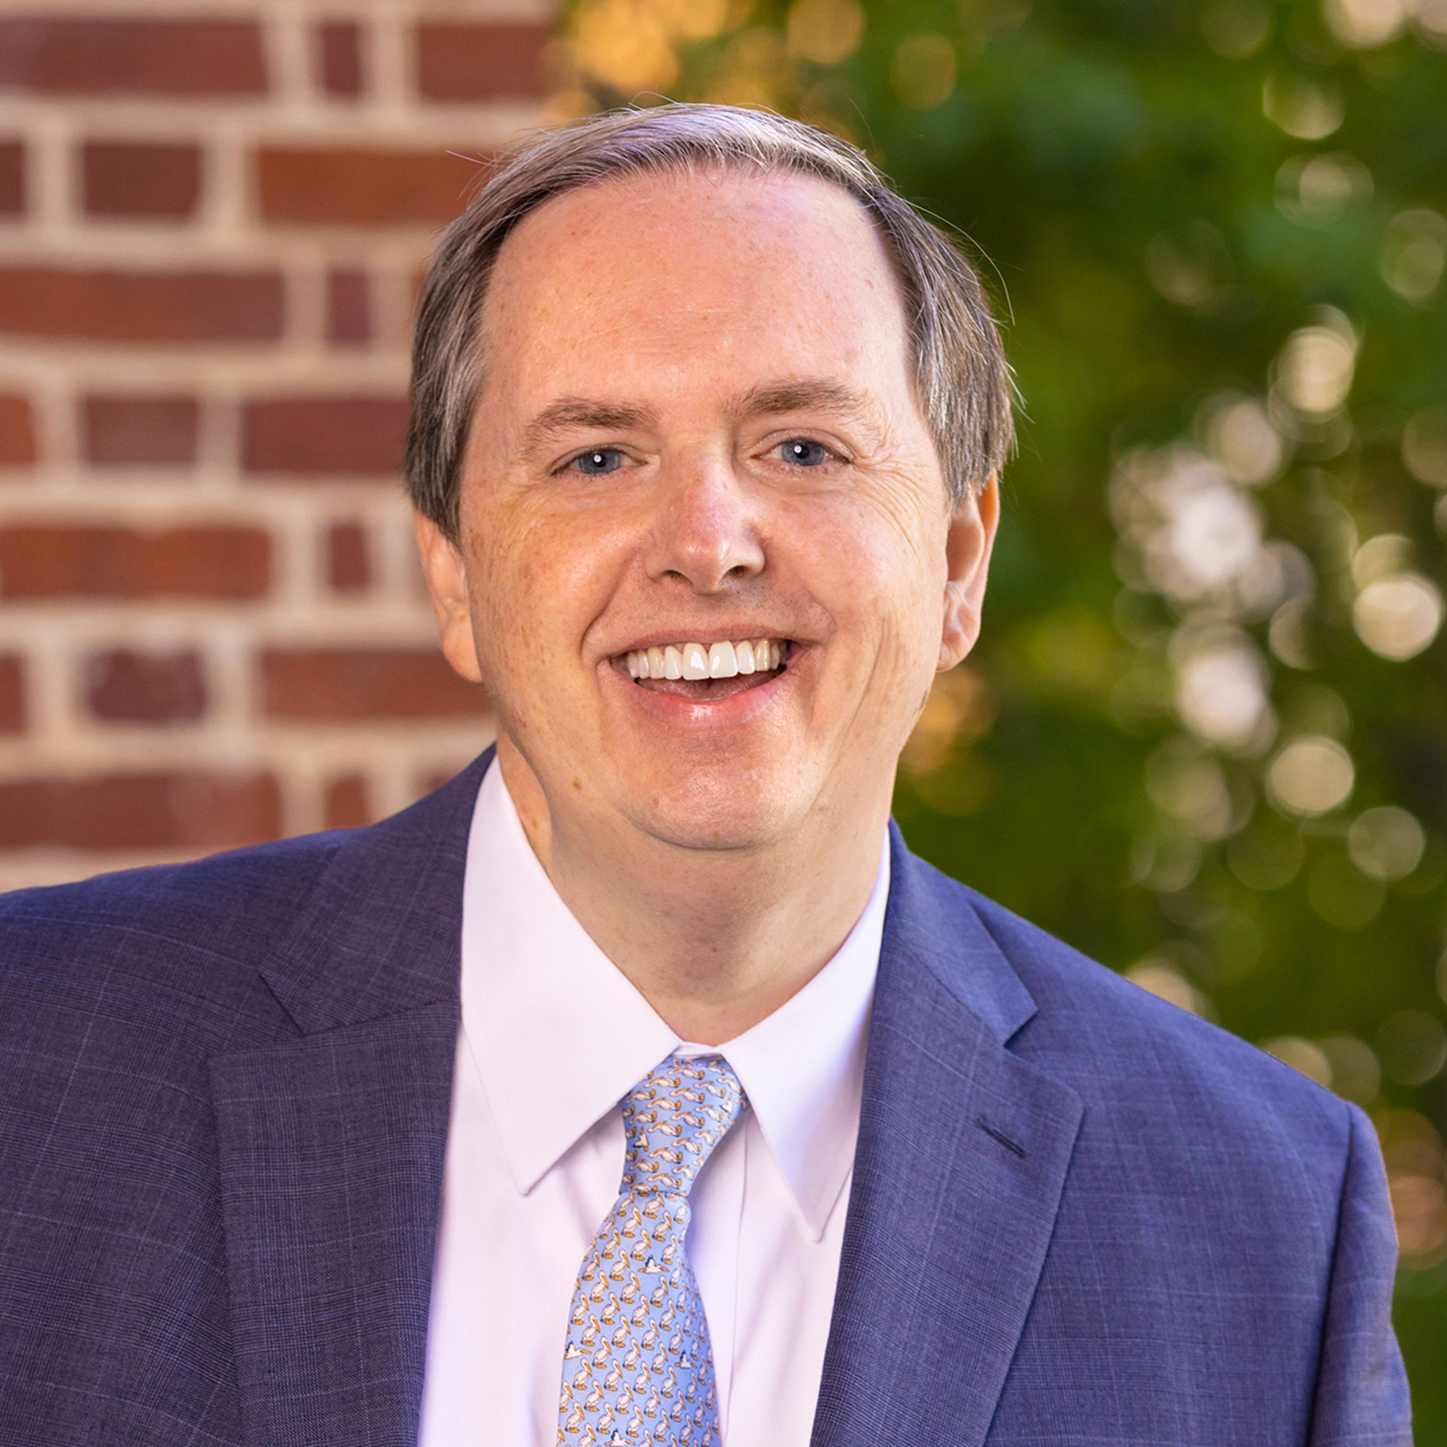
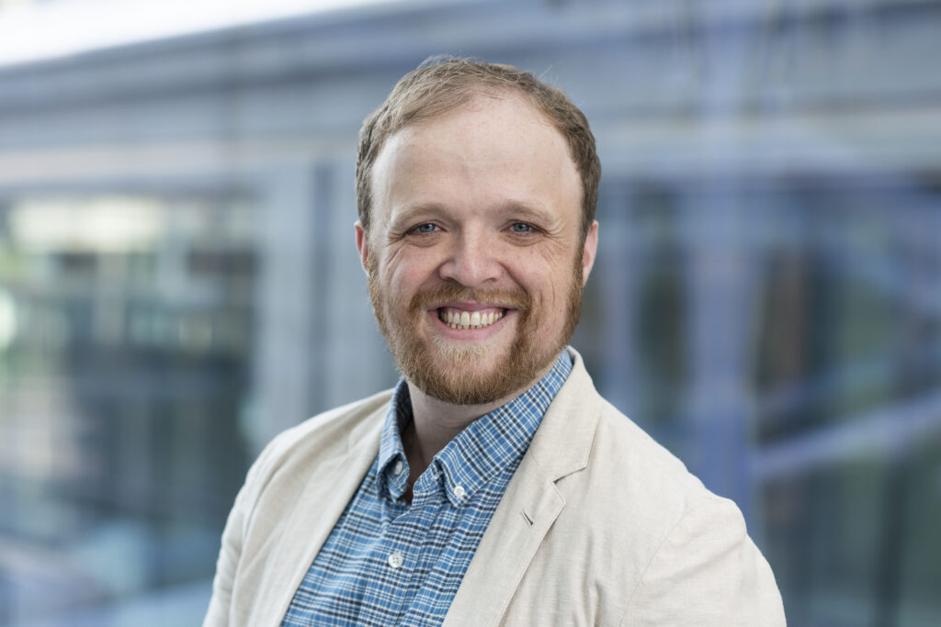
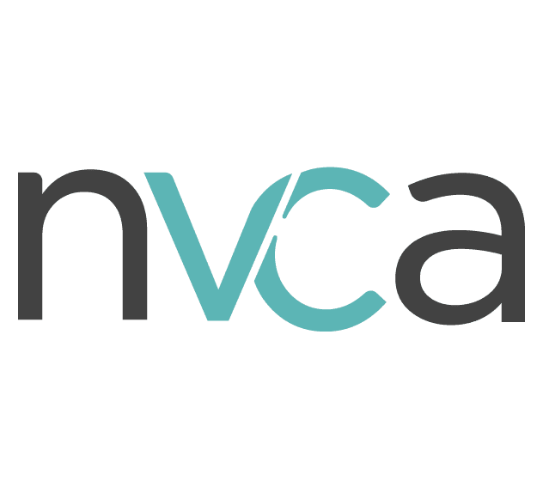
Today's speakers
Venture capital 101: The Basics of Venture Investing
Les Alexander (AlexanderL@darden.virginia.edu)
John Glynn Endowed Professor and Professor of Practice at the UVA Darden School of Business
Partner with Jefferson Capital Partners
Over 30 years of experience as a venture capitalist, professor, private equity investor, corporate executive, and investment banker.
Shiloh Tillemann-Dick (policy@nvca.org)
Research Director at the National Venture Capital Association (NVCA)
Studies the venture ecosystem with a focus on understanding its broader economic impacts and how they can be optimized.

Slide 3
Today’s Agenda
Venture capital 101: The Basics of Venture Investing
Capital Markets Overview
Venture Capital: Industry Overview
Venture Capital: How it Works
Venture Capital: Broader Impacts
Venture Capital: Policy Issues
Questions

Slide 4
Capital Markets Overview
Venture Capital 101: The Basics of Venture Investing, December 2024

Slide 5
Comparison of capital markets
Venture capital 101: The Basics of Venture Investing
Public Capital Markets
Public Equity (Stocks)
Public Debt (Bonds)
Private Capital Markets
Venture Capital
Private Equity
(and others)

Slide 6
Comparison of capital markets
Venture capital 101: The Basics of Venture Investing
Public Capital Markets
Liquidity
Time Flexibility
Larger Companies
More Established
Less Risk
Seeking Modest Returns
Passive Investment
Private Capital Markets
Illiquidity
Long-term Investment
Smaller Companies
Earlier Stage
More Risk
Seeking Higher Returns
Active Investment

Slide 7

VENTURE CAPITAL 101: THE BASICS OF VENTURE INVESTING
PRIVATE CAPITAL ECOSYSTEM
There are a number of different players that make up the private capital ecosystem, but venture capital is a critical component.

Slide 8
VENTURE CAPITAL 101: THE BASICS OF VENTURE INVESTING
PRIVATE CAPITAL ECOSYSTEM
Angels and Angel
Groups
Hedge Funds
Accelerators
Growth Equity
Family Offices
Buyout
Venture Capital
(seed, early-stage, late-stage, CVC)
Seed/Early-Stage (More Risk)
Later-Stage (Less Risk)

Slide 9
Venture Capital
Industry Overview
Venture Capital 101: The Basics of Venture Investing, December 2024

Slide 10
VC Fund Size
Venture capital 101: The Basics of Venture Investing
Median VC Fund Size?
Source: Pitchbook

Slide 11
Median Fund Size in 2023
Venture capital 101: The Basics of Venture Investing
$35.4M
Source: NVCA 2024 Yearbook

Slide 12
VC Fund Size
Venture capital 101: The Basics of Venture Investing
$714,000
Median management fee on the median VC fund.
Source: Pitchbook

Slide 13
VC Fund Size
Venture capital 101: The Basics of Venture Investing
Sample VC Operating Budget
  Salaries & benefits: $180k
  Office and rent: $120k
  Legal and accounting: $110k
  Travel: $70k
  Marketing: $65k
  Due diligence: $50k
  Software: $48k
  LP expenses: $40k
  Tech & databases: $31k
Source: Pitchbook

Slide 14



Industry Structure
Venture capital 101: The Basics of Venture Investing
Source: NVCA 2024 Yearbook

Slide 15
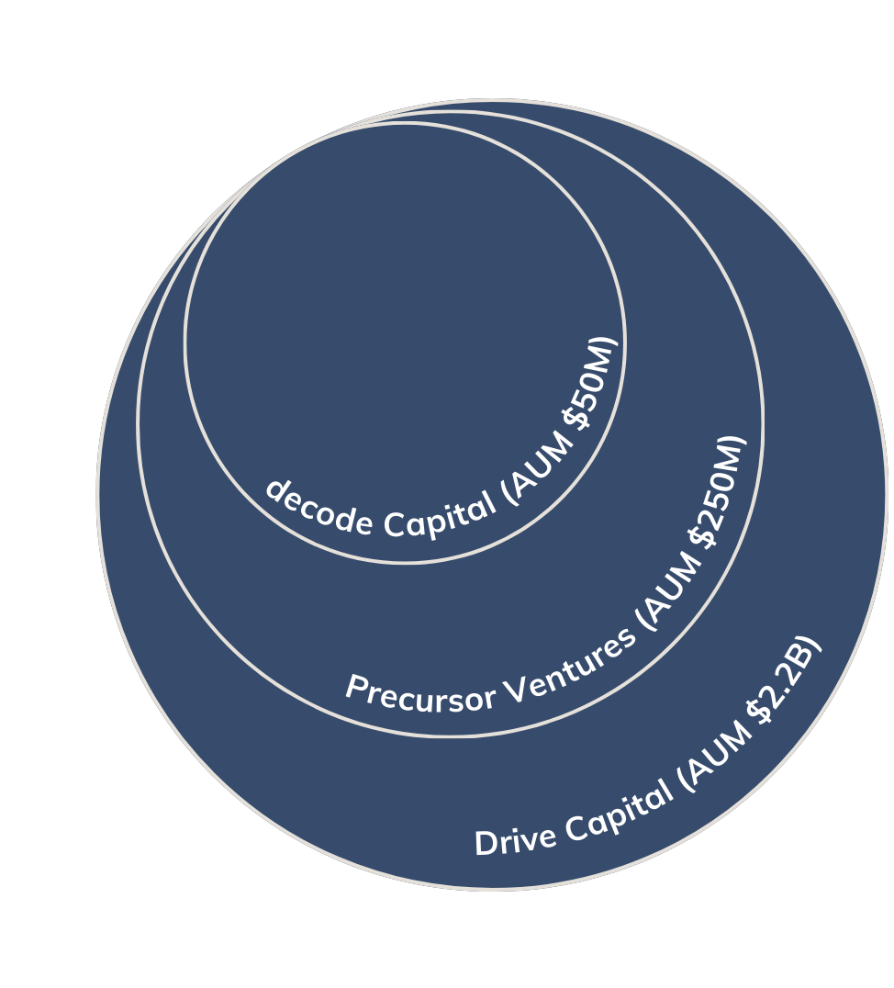

VC Fund Size
Venture capital 101: The Basics of Venture Investing
  NVCA represents a diverse range of venture capital firms.
  The median fund is approximately $35.4M, reflecting the variety of firms that fund startups and drive innovation nationwide.
decode Capital (AUM $50M)
Precursor Ventures (AUM $250M)
AUM = assets under management
Drive Capital (AUM $2.2B)

Slide 16




VC Fund Size: Small
Venture capital 101: The Basics of Venture Investing
$50.00M
AUM
REBECCA GEVALT,
MANAGING PARTNER
WASHINGTON, D.C.

Slide 17



VC Fund Size: Medium
Venture capital 101: The Basics of Venture Investing
$250.00M
AUM
CHARLES HUDSON,
MANAGING PARTNER AND FOUNDER
SAN FRANCISCO, CA

Slide 18


VC Fund Size: Large
Venture capital 101: The Basics of Venture Investing
$2.20B
AUM
MOLLY BONAKDARPOUR,
PARTNER
COLUMBUS, OHIO

Slide 19
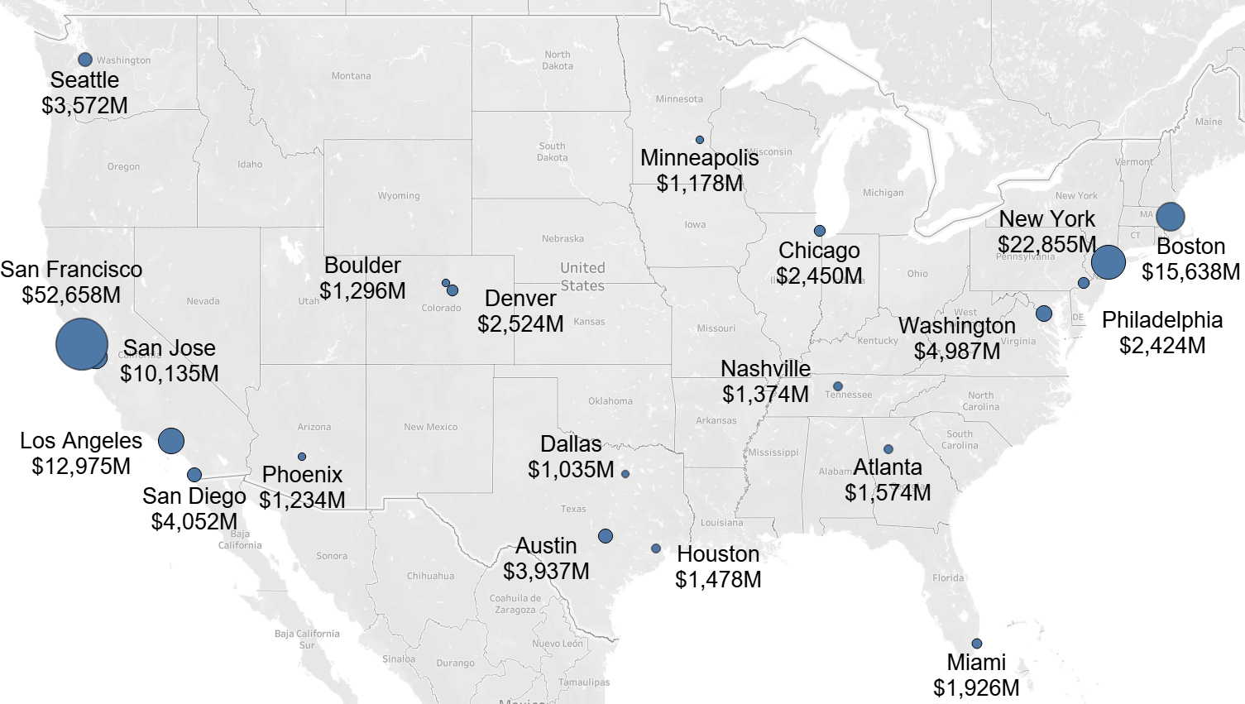
National Hotspots
Venture capital 101: The Basics of Venture Investing
Top Cities for VC Investment in 2023 ($M)
Source: NVCA 2024 Yearbook

Slide 20
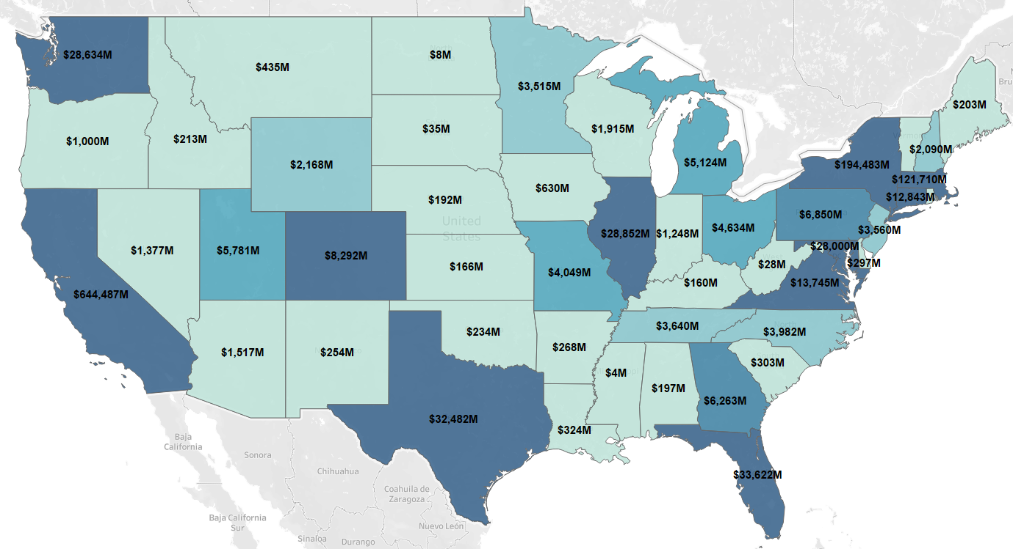
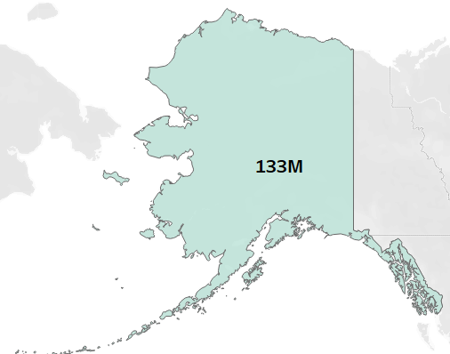
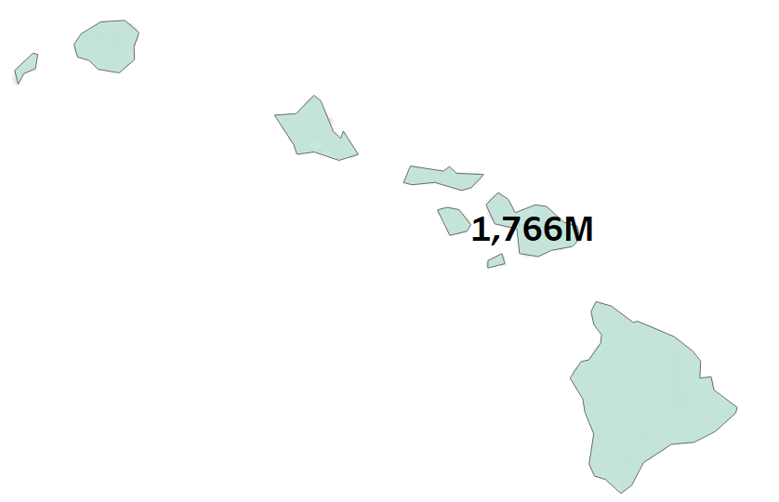
AUM Trends
Venture capital 101: The Basics of Venture Investing
VC Investment By State In 2023 ($M)
Source: NVCA 2024 Yearbook

Slide 21
Venture capital 101: The Basics of Venture Investing
VC Sectors
Source: NVCA 2024 Yearbook

Slide 22








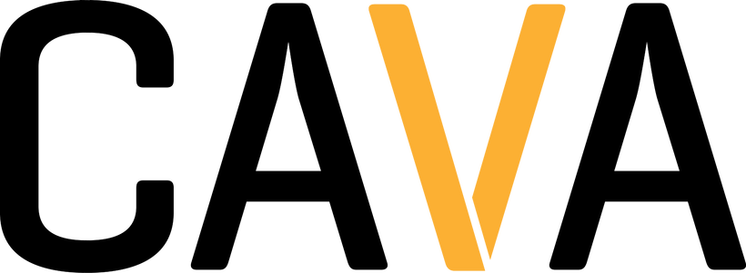



Recent VC Backed Startups
Venture capital 101: The Basics of Venture Investing
Software
Commercial Goods & Services
Consumer Products & Services
Source: NVCA 2024 Yearbook

Slide 23
Venture Capital
How It Works
Venture Capital 101: The Basics of Venture Investing, December 2024

Slide 24
Venture capital
Venture capital 101: The Basics of Venture Investing
Venture Capitalists provide capital to private businesses with high growth potential
Investments are generally high-risk and illiquid, making them unsuitable for traditional bank financing
To compensate for the risk, returns are high with funds generally targeting a 3x return
In addition to capital, venture capital firms help portfolio companies with personnel, operations, networking, and other issues
Venture capitalists provide a unique mix of financial and human capital which serves as rocket fuel for private companies about to take off

Slide 25






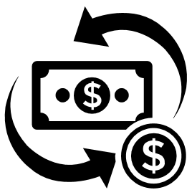





venture capital lifecycle
Venture capital 101: The Basics of Venture Investing
Re Investment
Investment
Exit
After about: 5-10 years of creating a high-growth company, the VC exits its stake via an acquisition or
IPO. IPOs have more advantages: greater capital raised, higher returns, local job creation.
The fund ends when all investments have been exited and proceeds have been distributed to LPs. LPs can then reinvest earnings in a new crop of funds.
VCs typically invest in young, high-growth companies in need of capital to scale.
Fundraising
Company Growth
Returns
VCs raise capital for funds from LPs
In addition to companies benefitting, VCs and LPs make a profit on their investment. High-quality jobs are created, more capital is available for university research, retirees have more for retirement, foundations have more resources to fund their work.
VCs provide active management and act as advisors & mentors, taking board seats, providing strategic advice, facilitating introductions.

Slide 26
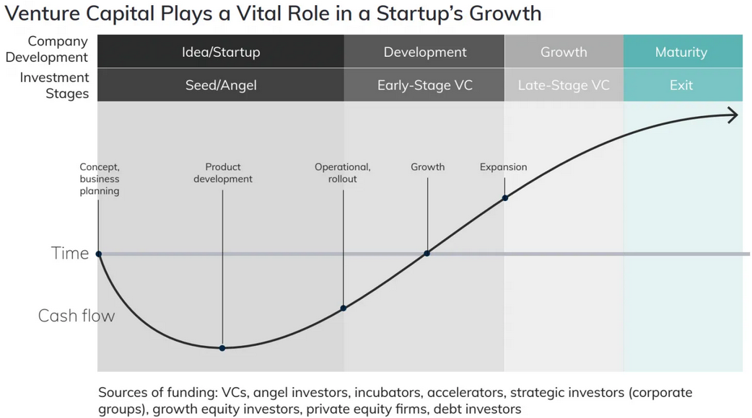
Venture capital
Venture capital 101: The Basics of Venture Investing
Source: Venture Forward

Slide 27
What Is a VC Fund?
Venture capital 101: The Basics of Venture Investing
General Partners
Limited Partners
Partners which handle the investment
i.e., Venture Capitalist
Partners which provide money to the fund
i.e., Non-Profit Endowments, Pension Funds, Family Offices
Venture Fund
Investment 1
Investment 5
Investment 2
Investment 4
Investment 3

Slide 28












Examples of Limited Partners
Venture capital 101: The Basics of Venture Investing
Endowments
Pensions
Nonprofits

Slide 29
What Is A VC fund? (cont’d)
Venture capital 101: The Basics of Venture Investing
Investment period (first 3-5 years)
Source and fund initial investments
Harvest period (second 5-7 years)
Support investments and seek to exit

Slide 30
How Does It Work?
Venture capital 101: The Basics of Venture Investing
​ |  | General Partner | Limited Partner
Primary Function​ |  | Active Investor | Capital Contributor​
Capital Contribution |  | 2% | 98%​
Compensation​ |  | 2% Management Fee | N/A​
Carried Interest​ |  | 20% | 80%
Limited Partners Contribute Most Of the Capital and Get Most Of The Profits. General Partners Contribute Their Time And Receive A Management Fee.

Slide 31
Management fees
Venture capital 101: The Basics of Venture Investing
In 2023, The Median US Fund Was $35.4 Million. Meaning $714k For Year 1 Management Fees

Slide 32


Investment process
Venture capital 101: The Basics of Venture Investing
Structure and Negotiate
Close Investment
Source Deals
Evaluate
Engage
Exit
Direct solicitation
Entrepreneur/Team
Structure
Documentation
Financial and operational performance
Form of liquidity event
Market Opportunity
Negotiate terms
Fund investment
Business & industry relationships
Term sheet
Timing
Industry/Competition
Board meetings & management calls
Valuation
Due Diligence
Financial projections
Accelerators
Tech transfer offices
Quarterly and annual reporting to Limited Partners

Slide 33
VC Partner Activities
Venture capital 101: The Basics of Venture Investing
Soliciting business
10%
Selecting opportunities
5%
61%
Analyzing business plans
5%
Negotiating investments
5%
Of partners interact weekly with their portfolio companies
Serving as directors and monitors
25%
70% of their time is adding value to portfolio companies
Acting as consultants
15%
Recruiting management
20%
Soliciting business
10%
Exiting
5%
Source: Strebulaev
Source: Strebulaev/ Harvard Business School

Slide 34

Power Law
Venture capital 101: The Basics of Venture Investing
A tiny fraction of VC investments will generate the majority of returns.
VCs are looking for home runs, not singles.
Source: Gosh
Notes:
Venture capital funds high risk, emerging private companies where many will fail
The VC fund needs to have some large successes to offset the losses

Slide 35
Challenging environment
Venture capital 101: The Basics of Venture Investing
Source: Pitchbook
Notes:
Venture capital funds high risk, emerging private companies where many will fail
The VC fund needs to have some large successes to offset the losses

Slide 36
Venture Capital
Broader Impacts
Venture Capital 101: The Basics of Venture Investing, December 2024

Slide 37
Job Growth from 1990 to 2022
Venture capital 101: The Basics of Venture Investing
TOTAL PRIVATE SECTOR
VC-BACKED GROWTH
43%
169%
VS
Source: Brown & Chow

Slide 38
Job Creation
Venture capital 101: The Basics of Venture Investing
6 million
62.5%
Americans employed by 54,000 VC-backed companies across all 50 states in 2023.
Of VC-backed-employment is located outside of California, Massachusetts, and New York.
Source: NVCA/UNC 2022

Slide 39

Most Valuable Companies by Market Cap
Venture capital 101: The Basics of Venture Investing
 | Market Cap | Country
Apple | $3.67 T | USA
Nvidia | $3.56 T | USA
Microsoft | $3.26 T | USA
Amazon | $2.29 T | USA
Google | $2.15 T | USA
Saudi Aramco | $1.80 T | Saudi Arabia
Meta | $1.55 T | USA
Tesla | $1.13 T | USA
TSMC | $1.05 T | Taiwan
Berkshire Hathaway | $1.01 T | USA
8 of the top 10 companies are American.
The American companies make up 87% of top company market cap.
7 of the top 10 companies were backed by venture capital.
82% of the overall top company market cap was originally VC backed.
Source: Statista

Slide 40
VC-BACKED COMPANIES DO AMERICA’S R&D
Venture capital 101: The Basics of Venture Investing
Source: Pitchbook

Slide 41
VC Creates Tremendous Value
Venture capital 101: The Basics of Venture Investing
All US Companies
Founded
1975-2015
All Publicly-Listed
US Companies
(2015)
Market Cap of All Publicly-Listed US Companies
(2015)
Source: Strebulaev & Gornall

Slide 42
Healthcare Innovation
Venture capital 101: The Basics of Venture Investing
60%
40%
VC investments are responsible for roughly 60% of new medicines.
VC investments are responsible for roughly 40% of new patents.
Source: Pitchbook

Slide 43



Defense Tech Innovation
Venture capital 101: The Basics of Venture Investing
25X
VC-Backed Defense Companies
VC investment into defense tech is up 25x over the
last decade in dollar terms.
Source: Chronograph.PE: 2024

Slide 44
AI Innovation
Venture capital 101: The Basics of Venture Investing
2,100%
50%
Growth in AI investments from 2019-2024
% of businesses integrating in 2024, up from 20% in 2020
Source: Pitchbook

Slide 45
Venture Capital
Policy Issues
Venture Capital 101: The Basics of Venture Investing, December 2024

Slide 46
VC Industry Policy Priorities
Venture capital 101: The Basics of Venture Investing
Tax bill
Regulatory
Antitrust
AI
Immigration
Healthcare
National Security
Climate
Blockchain/Crypto
R&D

Slide 47



NVCA Policy Team
Venture capital 101: The Basics of Venture Investing
Caroline Schellhas
Tax
Ashlyn Roberts
Capital markets
Healthcare
Tech commercialization
National security
SEC/regulatory
Crypto/blockchain
Jonas Murphy
AI
Antitrust
SSBCI
Immigration
Climate/energy

Slide 48


Thank You!

Slide 49
QUESTIONS

